Slide 1
Final Capstone: Application of Predictive Models to Automate Data Auditing
S Jadallah
Dec 20, 2019

Slide 2





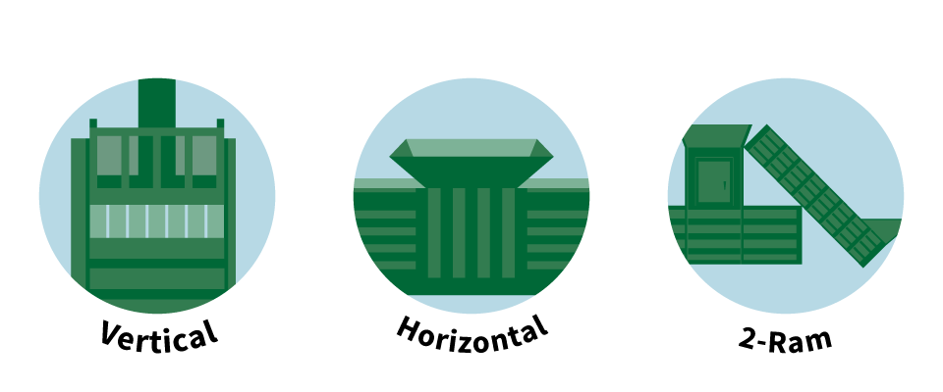

Current State
Deployment of smart devices for industry created data that is both structured and unstructured data.
User error of devices also lead to capture of erroneous structured data.
Early on with only several devices in the marketplace it was easy to have a person manually check all the records.
At 50+ devices the company developed an internal Audit software Tool to make it easier for the person to check the records and either ”Accept”, “Reject” or “Change the record.
Today with over 100 devices, growth in installations and the curse of dimensionality, we need a new solution.
Auditor
Analyst

Slide 3
The Problem
The Solution
To date the company has processed over 300K records and growing at a rate of ~15K per month.
Summary statistics show
95% of records are reviewed and Accepted
4.5% of records are rejected
0.5% of records are changed
Not a value-add activity for a person.
How can we automate this function so allow the person to perform more value-add work?
Data Science to the Rescue!
Build a model to predict which records should be “Accepted”, “Rejected” or “Changed” and liberate the person to perform value add activities for the business.

Slide 4
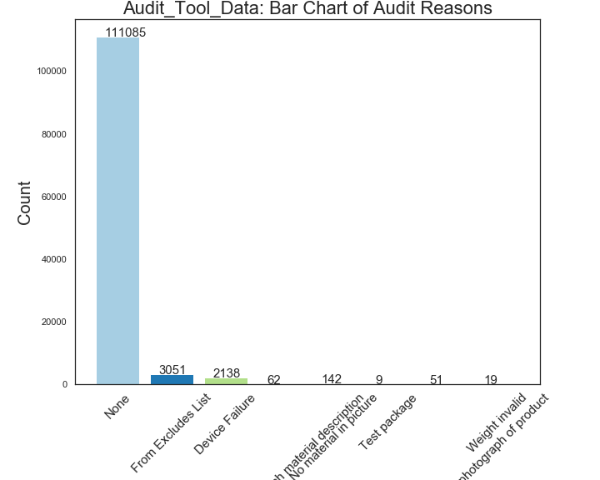
Dataset: Acquire, Clean, Explore & Repeat
Pulled records from Audit Tool software.
As this model would not include images, excluded all unstructured data.
Cleaned data
Created categorical variables for 6 features.
Audit_Status | Count | %
Accepted “A” | 146,030 | 95.4%
Rejected “R” | 6140 | 4.0%
Changed “C” | 878 | 0.5%

Slide 5
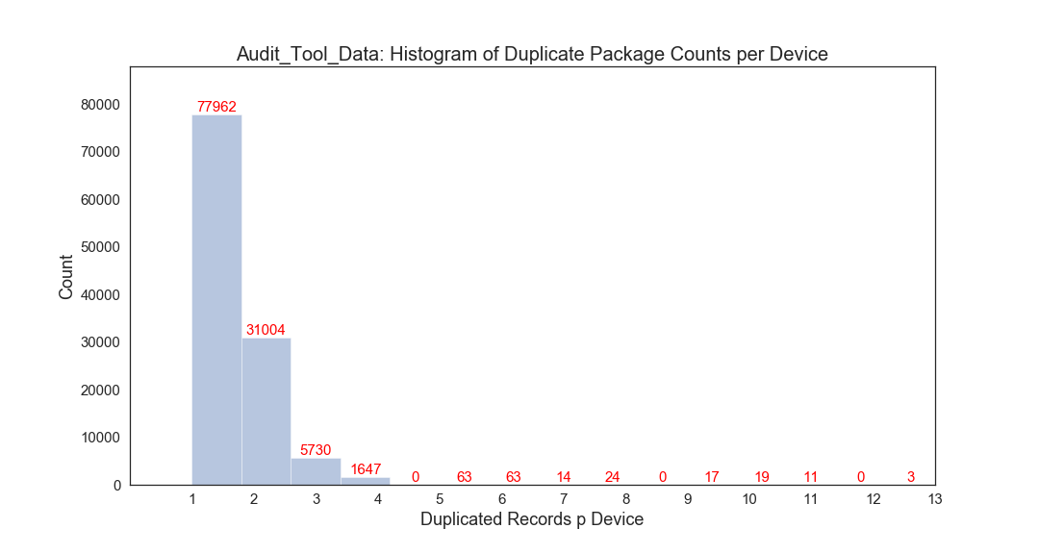
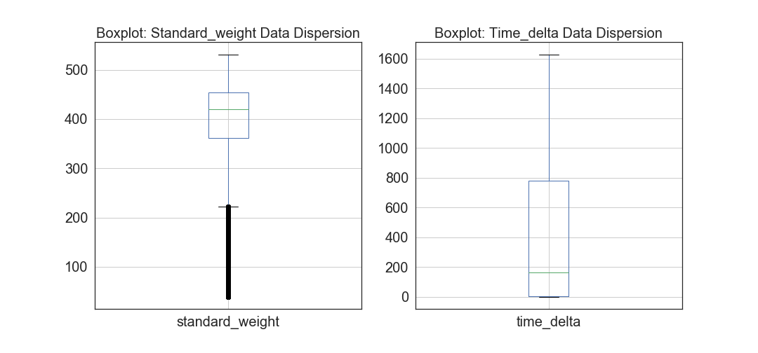
Dataset: Acquire, Clean, Explore & Repeat
Histogram of one of the engineered features: duplicated record count.
Boxplot of dispersion of standard weights and time-deltas; both were engineered features and both we treated for outliers.

Slide 6
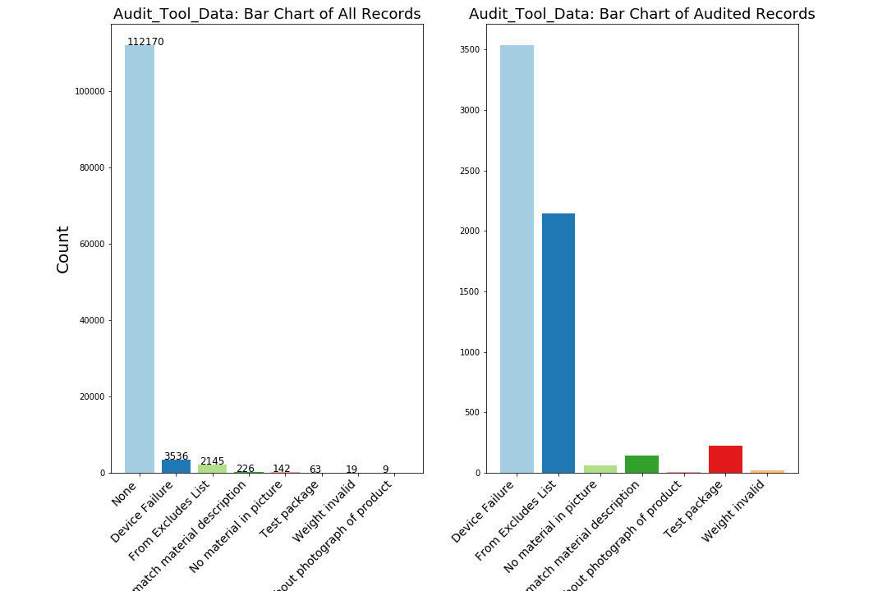
Dataset: Acquire, Clean, Explore & Repeat
First histogram is overall profile of distribution of records, by reason, that were either accepted (”None”) or rejected (all other reason codes).
Second histogram is same data removing the large dataset of the accepted records.

Slide 7
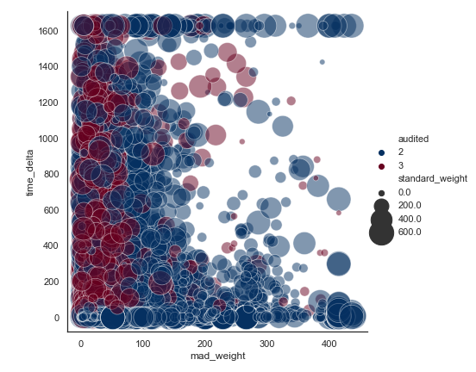
Dataset: Acquire, Clean, Explore & Repeat
Relationship plot to test if visually there was a clear relationship between the mean absolute deviation in weight and the time delta.
Both are engineered features.

Slide 8
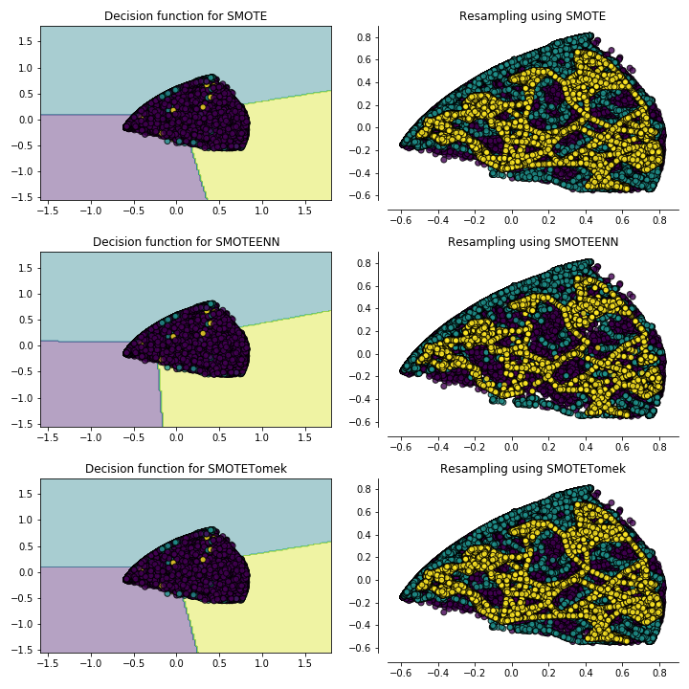
Dataset:
Imbalanced Data
During EDA and initial modeling the models were overfitting due to large imbalance in data.
The “Accepted” records were dominate therefore skewing results of models.
Applied a SMOTE, SMOTEENN and SMOTETomek random under/over sampler to balance the data.
This approached was used to minimize data loss.

Slide 9
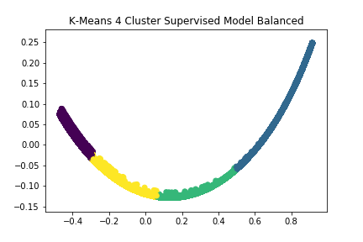
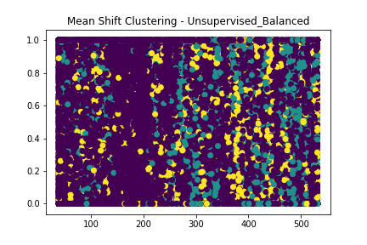
Model Building Cluster ****
These were supervised learning models.
Decided to test both clustering, and neural network models.
Clustering models included:
K-Means
Mean-shift
MLP Neural Network model.
The data was not a good fit for any of these models!
MLP Classification Report

Slide 10
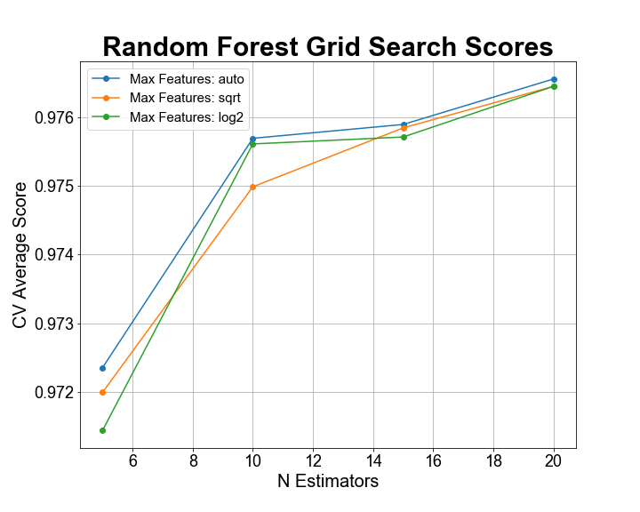
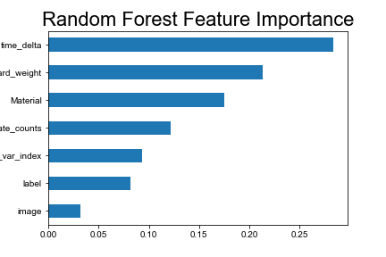
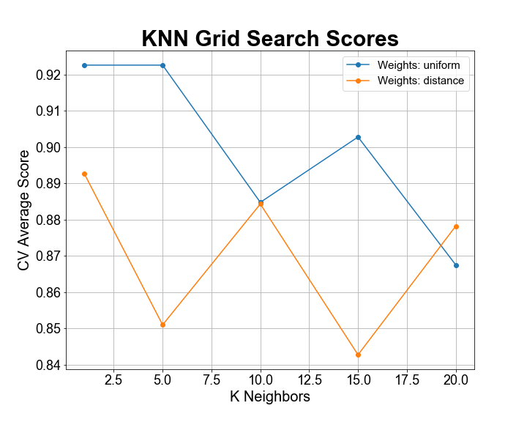
Model Building Classification Models
Analyzed various parameters and their impact on the model’s predictiveness.
Identified feature importance to improve model’s predictiveness.
Most improvements on models came from feature engineering versus parameter tuning.

Slide 11
Model Building Classification Models
Random Forest Classification Report: Default Parameters
 | precision | recall | f1-score | support
1 | 0.9725 | 0.9751 | 0.9738 | 22,624
2 | 0.9836 | 0.9757 | 0.9796 | 22,757
3 | 0.9810 | 0.9862 | 0.9836 | 22,773
accuracy | 0.9790 | 0.9790 | 0.9790 | 0.9790
macro avg | 0.9790 | 0.9790 | 0.9790 | 68,154
weighted avg | 0.9790 | 0.9790 | 0.9790 | 68,154
Random Forest Classification Report: Tuned Parameters
 | precision | recall | f1-score | support
1 | 0.9206 | 0.9639 | 0.9418 | 22,624
2 | 0.9807 | 0.9493 | 0.9647 | 22,757
3 | 0.9504 | 0.9365 | 0.9434 | 22,773
accuracy | 0.9498 | 0.9498 | 0.9498 | 0.9498
macro avg | 0.9506 | 0.9499 | 0.9500 | 68,154
weighted avg | 0.9506 | 0.9498 | 0.9500 | 68,154
Random Forest models performed the best.
Random Forest model with default parameters performed best
Iterated through the models and feature enhancement has the most positive impact on model’s predictiveness.
KNN model was optimal with n=1.
KNN Classification Report: n_neighbors: 1
 | precision | recall | f1-score | support
1 | 0.9558 | 0.8487 | 0.8990 | 22,499
2 | 0.9430 | 0.9677 | 0.9552 | 22,840
3 | 0.9029 | 0.9789 | 0.9393 | 22,815
accuracy | 0.9322 | 0.9322 | 0.9322 | 0.9322
macro avg | 0.9339 | 0.9318 | 0.9312 | 68,154
weighted avg | 0.9338 | 0.9322 | 0.9313 | 68,154

Slide 12
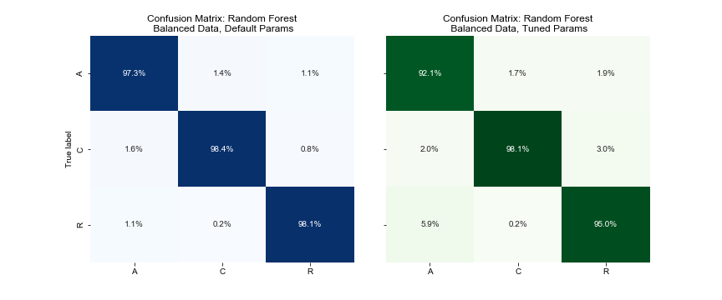
Random Forest Models Confusion Matrices
Classification models performed much better
Applied data to following models
Decision Tree
Random Forest
KNN
Classification models perform very well

Slide 13
Conclusions & Next Steps
Model will be moved into dev environment for user testing.
Will add image classification model (already built) to enhance predictiveness of model.
Test, adjust and deploy once we pass testing metrics.
Modify Audit Tool software to only show user those records classified as “Change.”
Modify Audit Tool software to randomly sample records for re-training of model.
Questions & Answers

